Slide 1
Onboarding Assignment

Slide 2
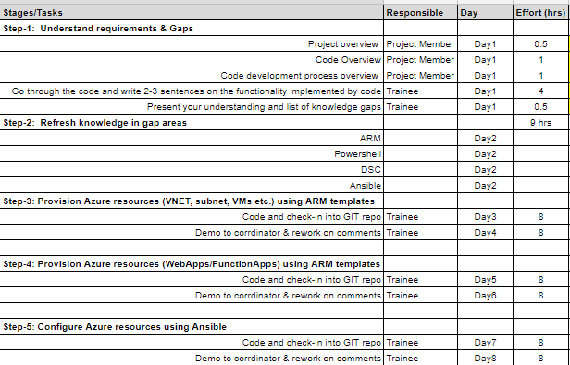
Overview
Purpose of this assignment is to refresh practitioner’s knowledge on Azure and Automation. Intended audience for the assignment are new Globers with Azure experience, to be proposed on EY engagement. High level schedule is as follows:

Slide 3
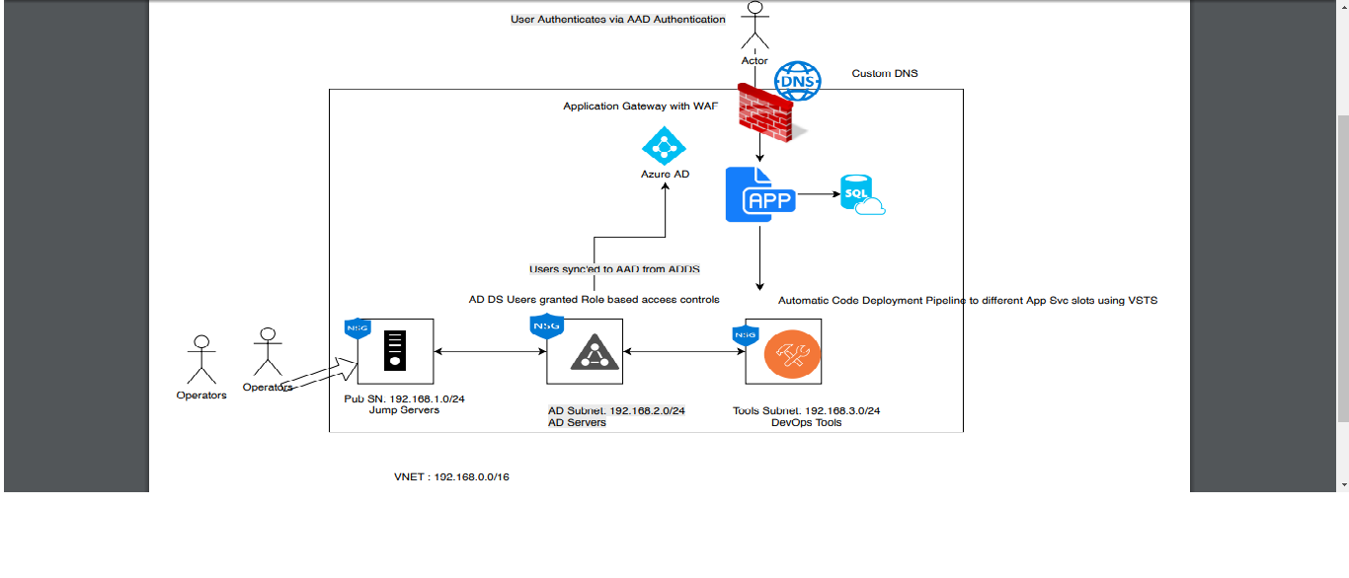
Architecture Diagram
Ass

Slide 4
Key Implementation points
ARM templates must be used for provisioning Azure resources
Ansible & Powershell DSC must be used for configuration management. E.g creation of users,
Provision VNET with 3 different Subnets
Each subnet must be associated with it’s own NSG
In Jump Subnet(SN) NSG, Allow RDP from Internet to jump servers
In AD SN, no internet should be allowed and all AD servers should only be in Private SN. Connection to AD servers should only be allowed via Jump servers.
Users connecting to jump servers/AD servers should only be able to connect using their domain credentials.
AD DS should be synced to Azure AD via Azure AD Connect.
‘Tools subnet’ is for deploying a 3rd party tool. Tool, assigned to you, must be installed into this subnet and must be made available using a custom domain.

Slide 5
Key Implementation points contd..
Slots have to to be created for App service for multiple environments.
Code must be deployed to next level only if everything is working in lower environments.
Deployment of AD, Tools, etc to be done via PowerShell DSC/ARM templates.
Custom DNS setting can be manual
Users should authenticate to AAD before they can access app service from outside over internet.
Tool must be be accessible over internet using custom DNS.
Azure VSTS must be used to deploy code to Azure App services
All code has to be checked into VSTS or GIT
ARM best practices have to be applied : https://docs.microsoft.com/en-us/azure/azure-resource-manager/template-best-practices

Slide 6
Important links
Sl No | Topics | Materials
1 | Read about DevOps | https://sites.google.com/globant.com/trainings/devops/devops-foundations
2 | Read about Cloud Computing | https://sites.google.com/globant.com/trainings/cloud-computing/cloud-fundamentals
3 | Overview of IAAC tools | https://sites.google.com/globant.com/trainings/devops/devops-foundations/infrastructure-as-code-tools
4 | Azure | https://docs.microsoft.com/bs-latn-ba/azure/index
5 | Read about Powershell | https://docs.microsoft.com/en-us/powershell/scripting/powershell-scripting?view=powershell-6
6 | Read about Powershell DSC | https://docs.microsoft.com/en-us/powershell/dsc/overview
7 | Azure Quickstart templates | https://github.com/Azure/azure-quickstart-templates

